Slide 1

Tracking Your Expenses Has Never Been Easier

Slide 2

Expenditure Tracker
Where you can easily keep track of your expenses by just taking a photo of your invoice and using flask interface. Our system uses Amazon Textract to detect the amount and update a JSON file in S3 and displays the updated amount seamlessly on the interface.

Slide 3


Technical Details
EC2 Instances and S3 Bucket
We use EC2 instances to run our Flask interface and save the invoice image to our S3 bucket. The billing data is updated in our JSON file present in the S3 bucket.

Slide 4

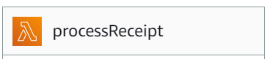
Technical Details
Lambda Function and Amazon Textract
When the invoice image is saved to the S3 bucket, it triggers a Lambda function which uses Amazon Textract to extract the amount from the invoice.

Slide 5
The Workflow
1
2
3
4
5
6
Upload
Save
Trigger
Extract
Update
Display
Upload invoice image to Flask interface
Save image to S3 bucket
Trigger Lambda function
Use Amazon Textract to extract the amount from the bill
Update the JSON file in S3
Display the updated amount on the Flask interface

Slide 6
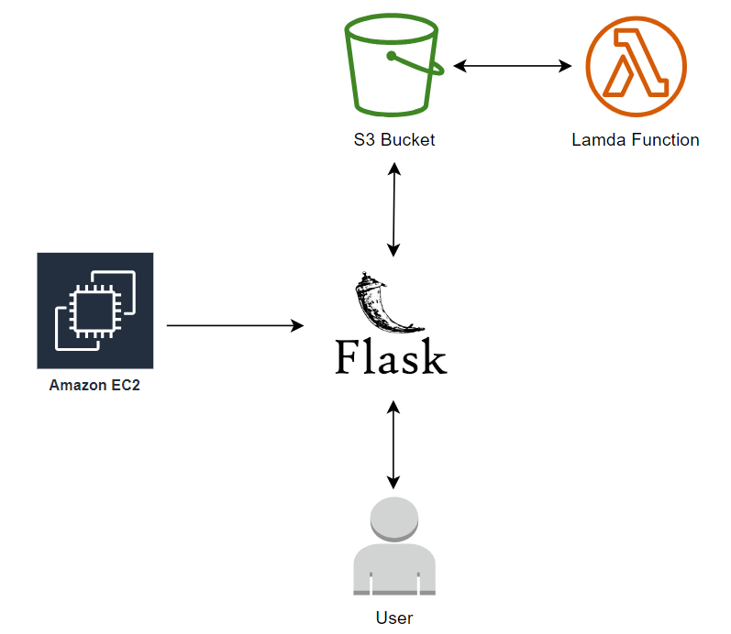
The Architecture

Slide 7
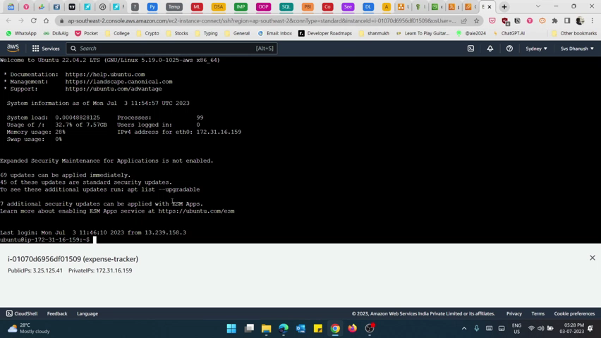

Slide 8

Conclusion and Future Improvements
1
Conclusion
2
Future Improvements
Our expenditure tracker offers a quick, convenient, and accurate way to keep track of expenses. It is accessible and eco-friendly to use, and saves time and effort through automation.
Future improvements may include integration with accounting software, multiple bill detection, and data analysis.

